Slide 1
Lecture 5:
Op-amp Voltage Transfer Characteristics

Slide 2
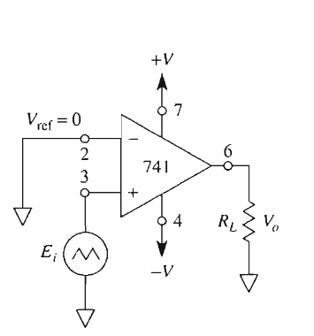
Basic Op-Amp Configurations
Open-loop Configurations
Comparator / Voltage Level Detectors
Closed Loop Configurations
Voltage Follower
Inverting Amplifier
Inverting Summer
Non-Inverting Amplifier
Weighted Subtractor
Integrator
Differentiator
Exponential Converter
Logarithmic Converter
Multiplier
Divider

Slide 3
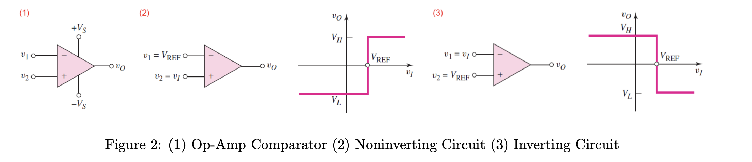

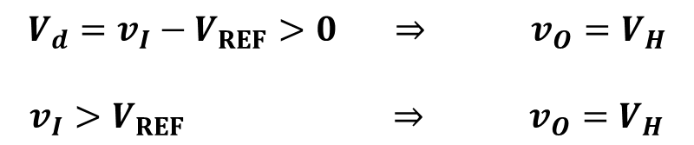

Open Loop (Comparator) – VTC (NON-INVERTING)
NON-INVERTING Level Crossing Detector / Comparator
$$\{$$
$$V_{d}=v_{I}−V_{REF}$$
$$V_{d}=v_{I}−V_{REF}>0 ⇒ v_{O}=V_{H}$$
$$v_{I}>V_{REF} ⇒ v_{O}=V_{H}$$

Slide 4
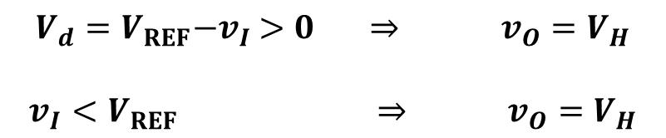


Open Loop (Comparator) – VTC (INVERTING)
INVERTING Level Crossing Detector / Comparator
$$\{$$
$$V_{d}=V_{REF}{−v}_{I}$$
$$V_{d}=V_{REF}{−v}_{I} >0 ⇒ v_{O}=V_{H}$$
$$v_{I}<V_{REF} ⇒ v_{O}=V_{H}$$

Slide 5
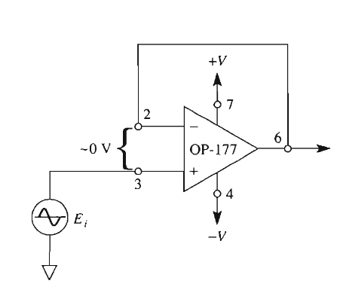
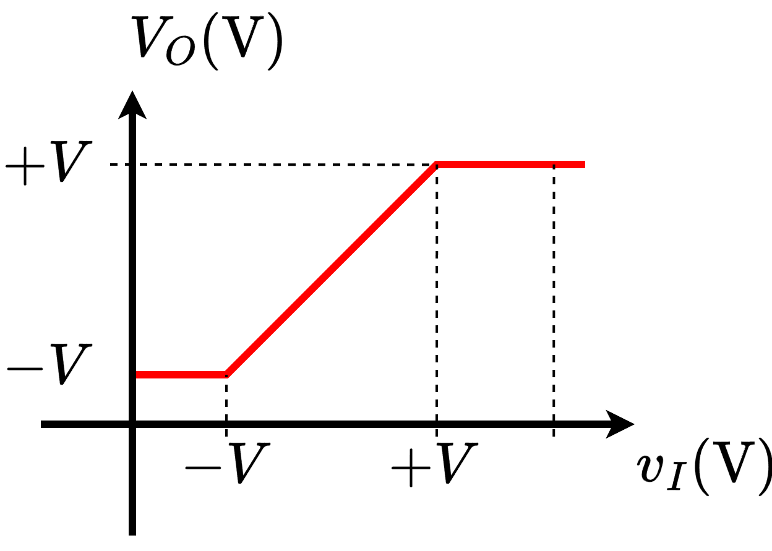
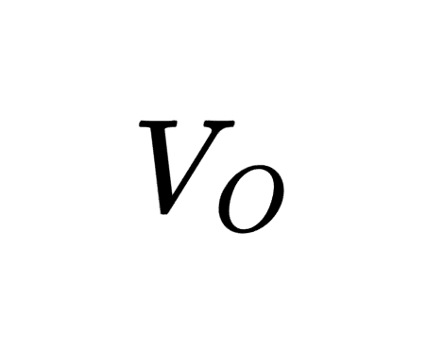
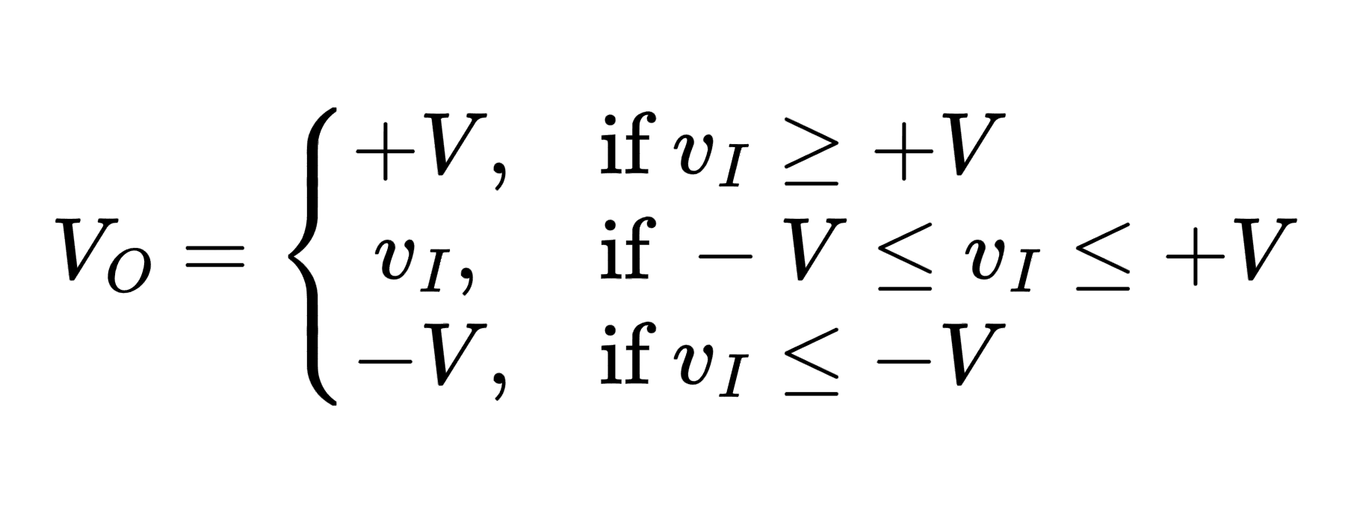

Voltage Follower – VTC
$$v_{I}$$

Slide 6
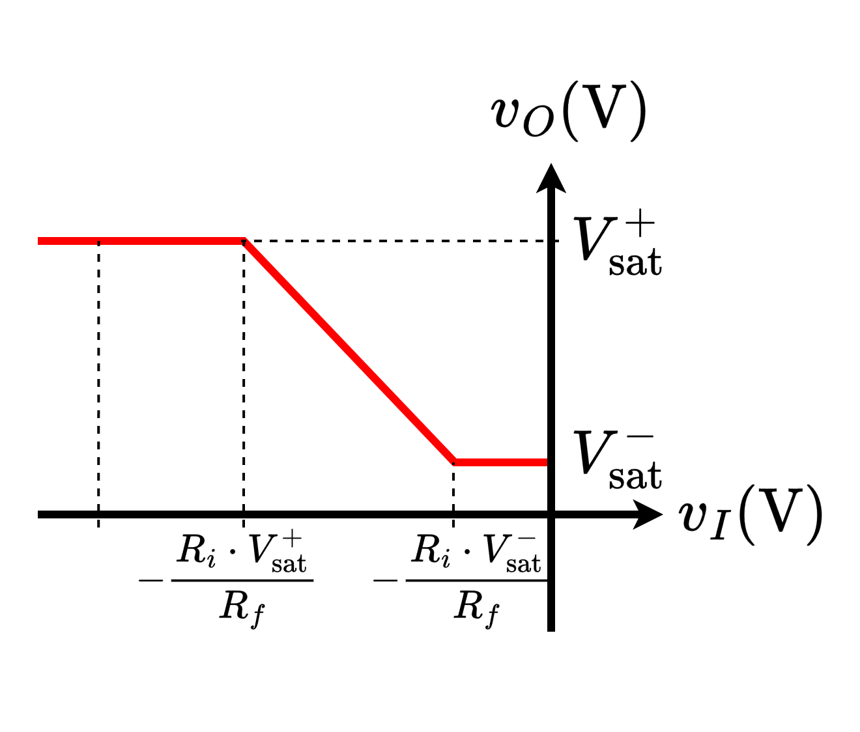
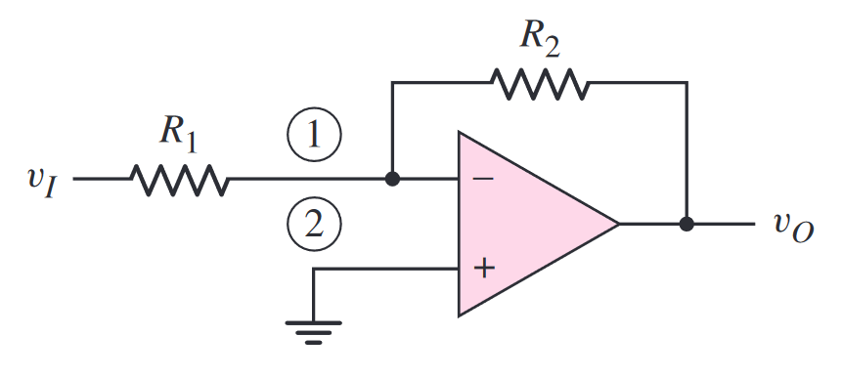
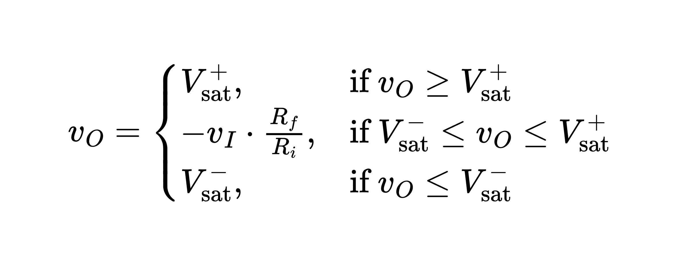


Inverting Amplifier – VTC
$$R_{f}$$
$$R_{i}$$

Slide 7
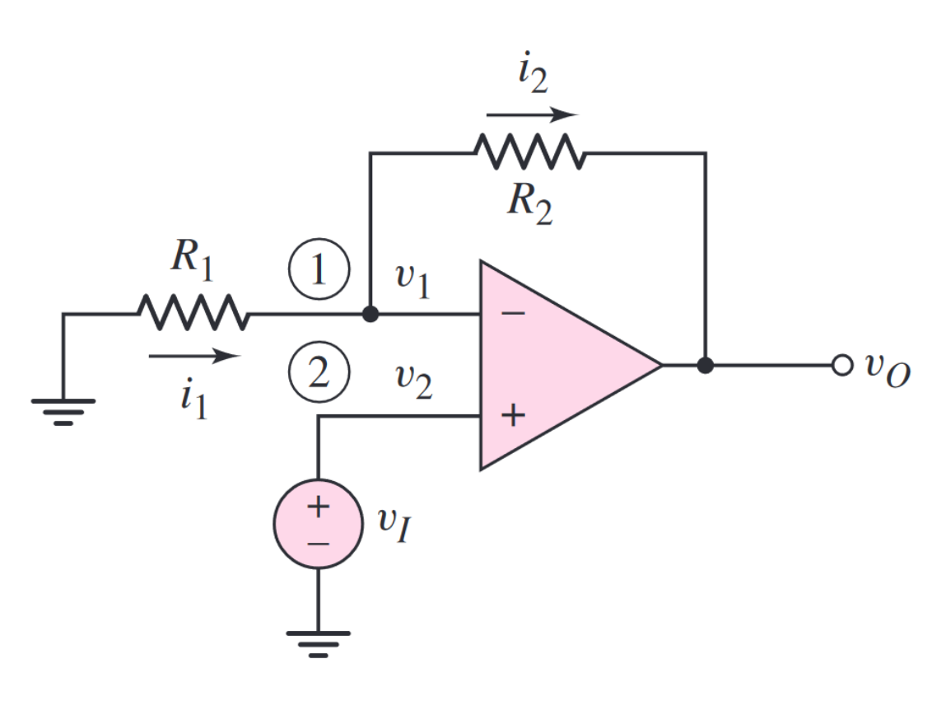
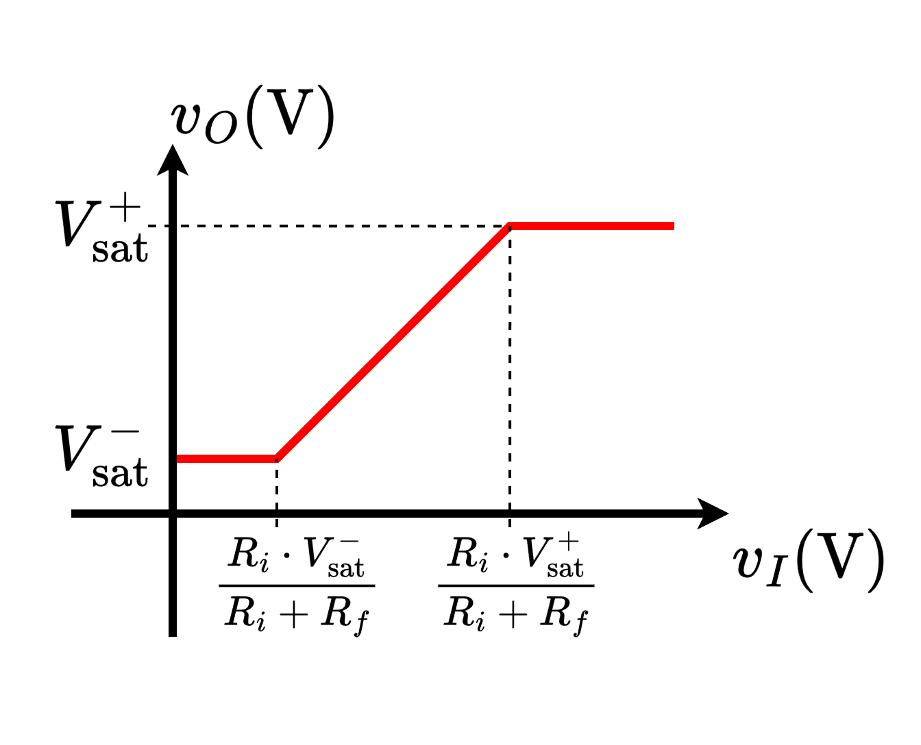
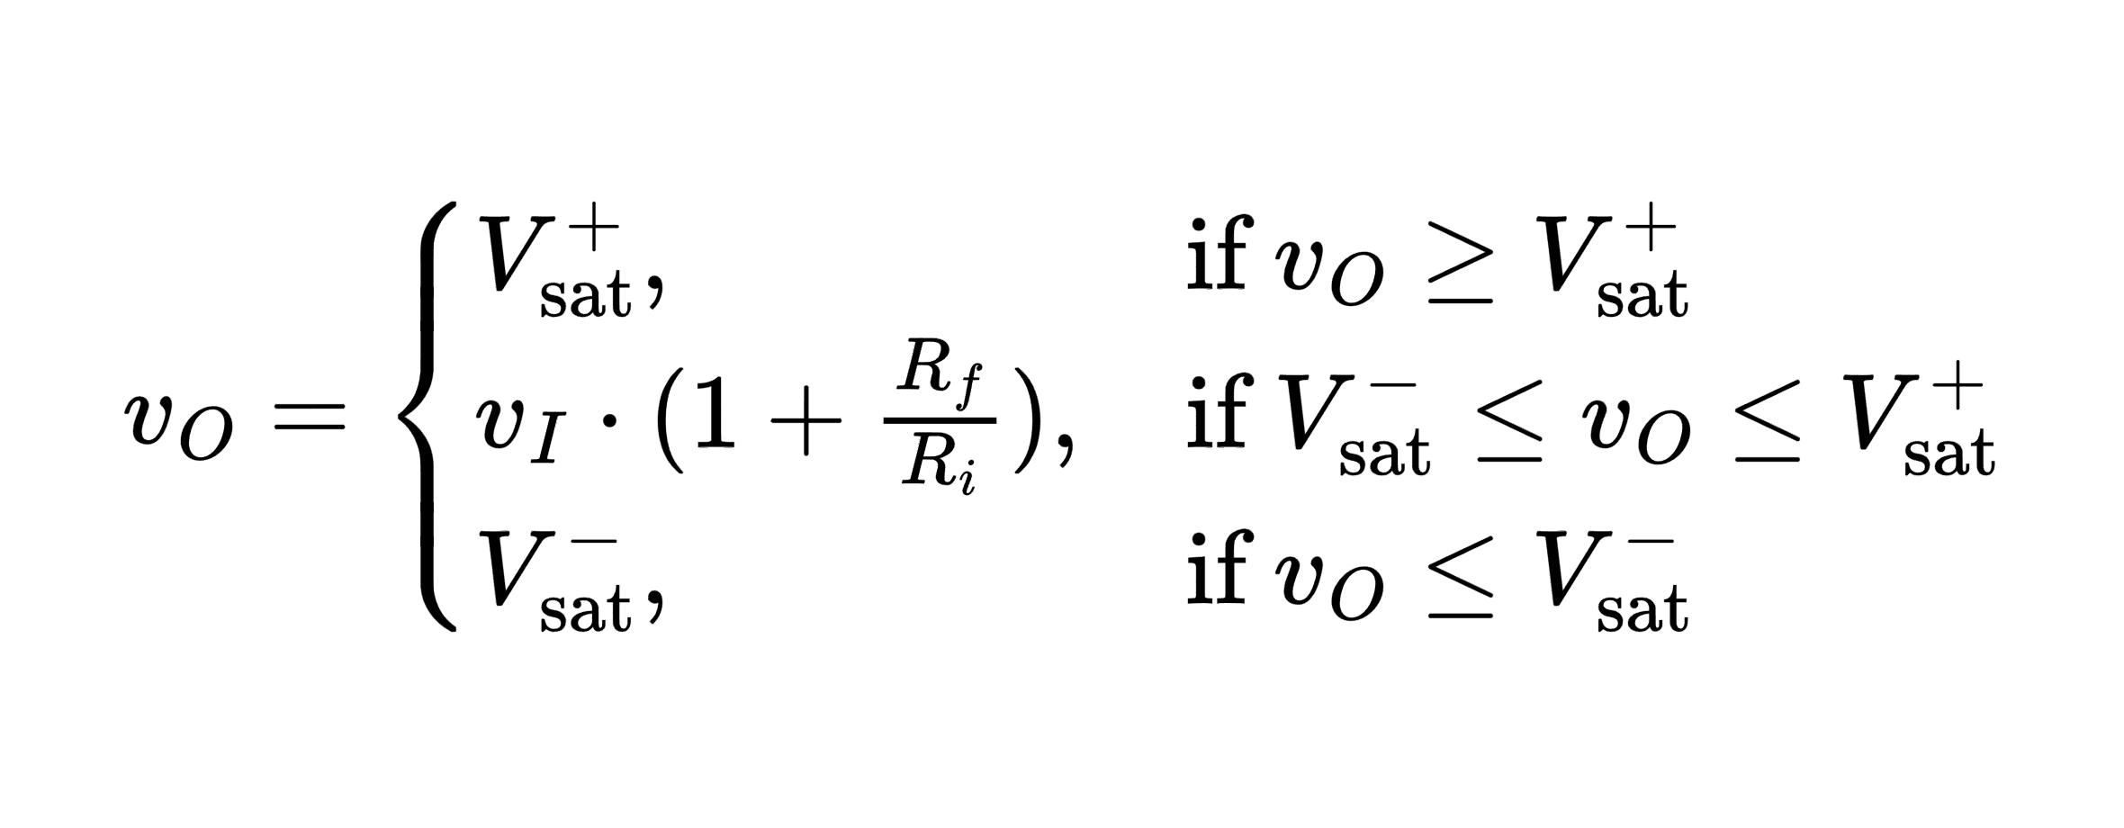


Non-Inverting Amplifier – VTC
$$R_{i}$$
$$R_{f}$$

Slide 8
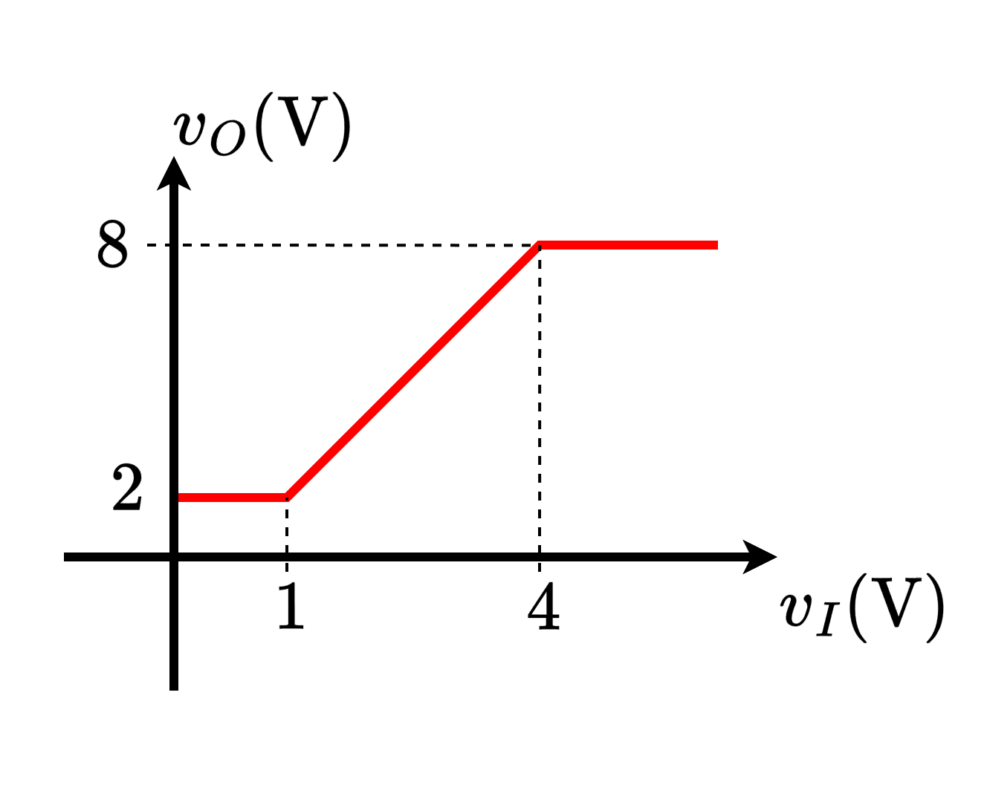
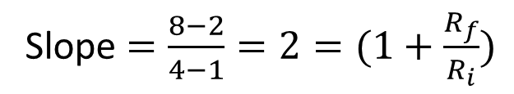




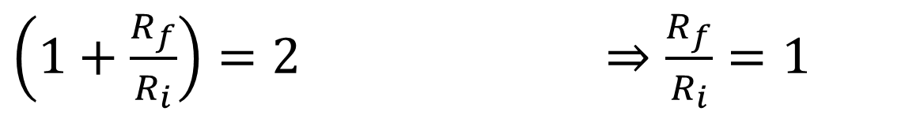
Non-Inverting Amplifier – VTC
Draw an Op-Amp Circuit with the following VTC
Slope $=\frac{8−2}{4−1}=2=(1+\frac{R_{f}}{R_{i}})$
$$1 kΩ$$
$$8 V$$
$$1 kΩ$$
$$2 V$$
$\left(1+\frac{R_{f}}{R_{i}}\right)=2$ $⇒\frac{R_{f}}{R_{i}}=1$

Slide 9
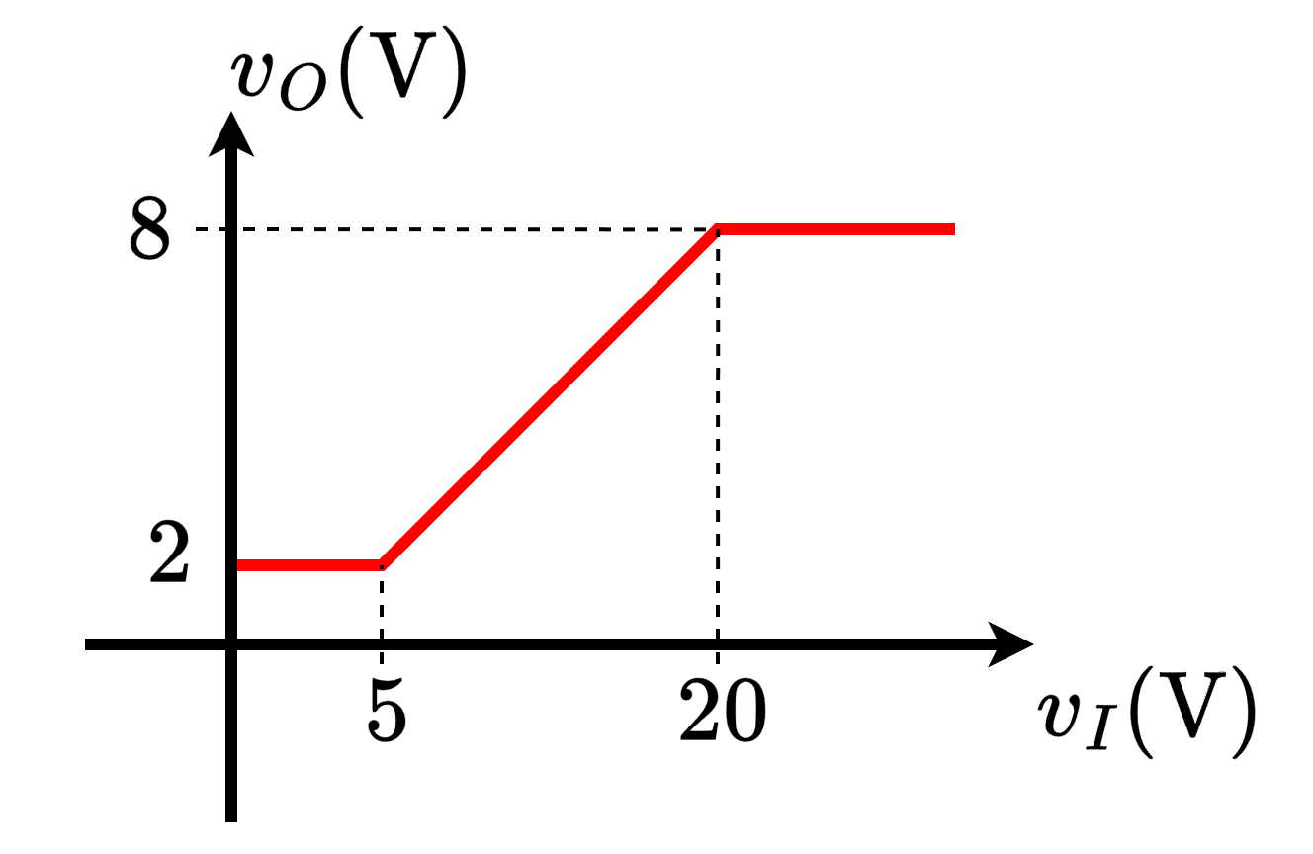

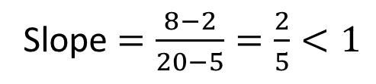
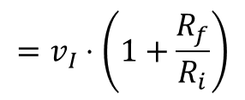
Non-Inverting Amplifier – VTC
Draw an Op-Amp Circuit with the following VTC. (What if the slope is less than 1?)
$$R_{i}$$
$$R_{f}$$
$$=v_{I}⋅\left(1+\frac{R_{f}}{R_{i}}\right)$$
Slope $=\frac{8−2}{20−5}=\frac{2}{5}<1$
A non-inverting amplifier closed loop gain $\left(1+\frac{R_{f}}{R_{i}}\right)>1$. So, it is not possible to use this configuration for less than unity gain.

Slide 10
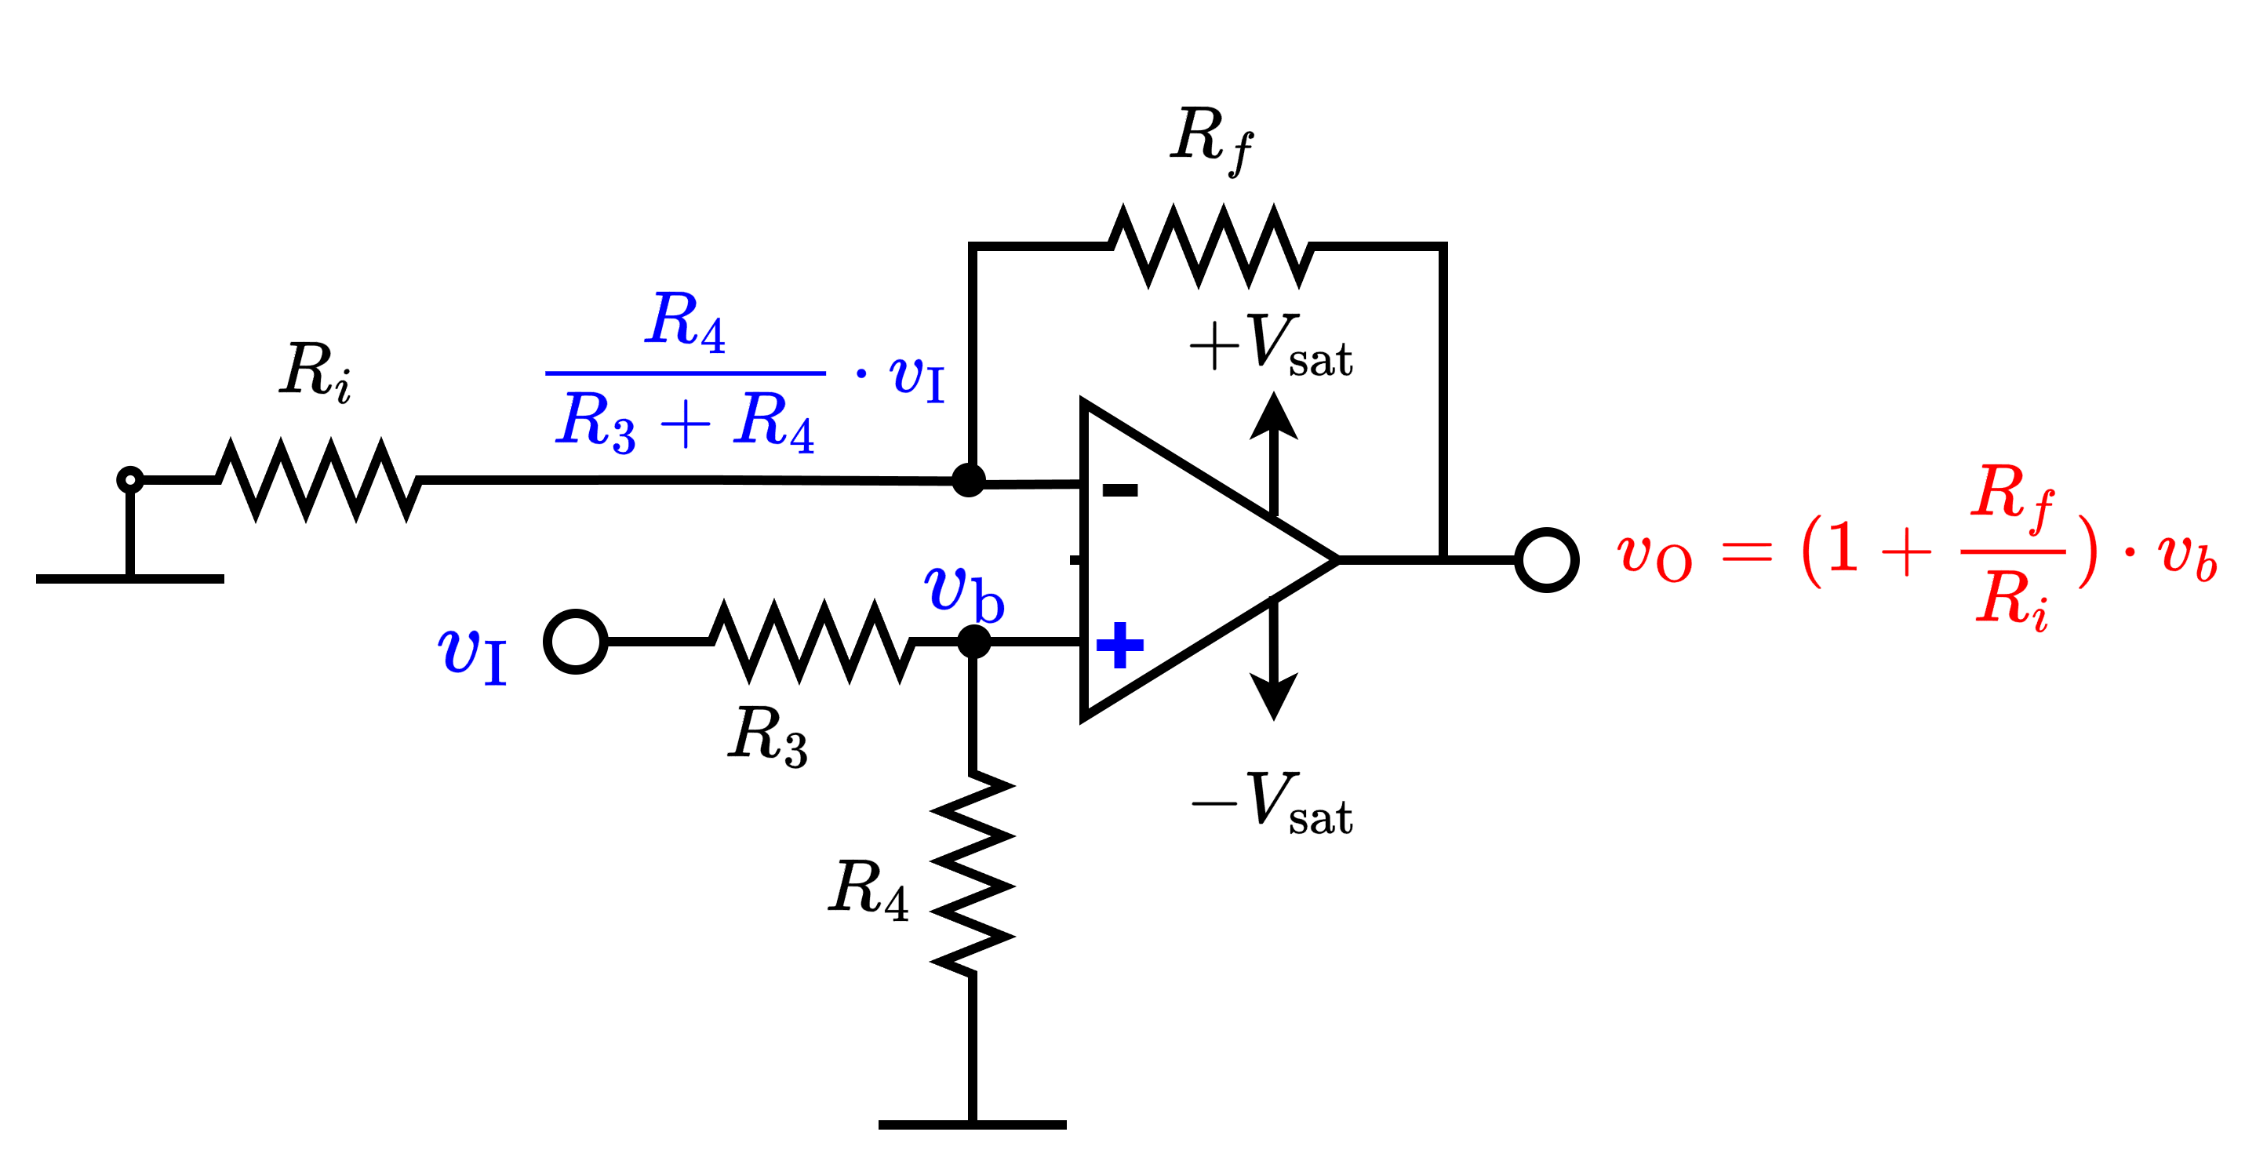
Non-Inverting Amplifier – VTC
Draw an Op-Amp Circuit with the following VTC. (What if the slope is less than 1?)
$$R_{i}$$
$$R_{f}$$
$$=v_{I}⋅\left(1+\frac{R_{f}}{R_{i}}\right)$$
Slope $=\frac{8−2}{20−5}=\frac{2}{5}<1$
If Slope < 1, then, an additional voltage divider network should be added to the non-inverting terminal.

Slide 11
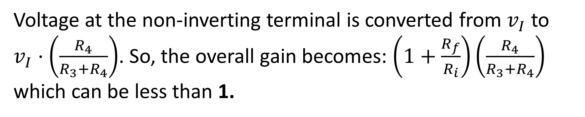
Non-Inverting Amplifier – VTC
Draw an Op-Amp Circuit with the following VTC. (What if the slope is less than 1?)
Slope $=\frac{8−2}{20−5}=\frac{2}{5}<1$
Voltage at the non-inverting terminal is converted from $v_{I}$ to $v_{I}⋅\left(\frac{R_{4}}{R_{3}+R_{4}}\right)$. So, the overall gain becomes: $\left(1+\frac{R_{f}}{R_{i}}\right)\left(\frac{R_{4}}{R_{3}+R_{4}}\right)$ which can be less than 1.

Slide 12

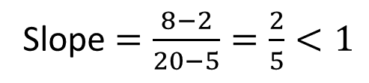
Non-Inverting Amplifier – VTC
Draw an Op-Amp Circuit with the following VTC. (What if the slope is less than 1?)
So, $\left(1+\frac{R_{f}}{R_{i}}\right)\left(\frac{R_{4}}{R_{3}+R_{4}}\right)=\frac{2}{5}$ can be true if:
$$\left(1+\frac{R_{f}}{R_{i}}\right)=2$$
and
$$\left(\frac{R_{4}}{R_{3}+R_{4}}\right)=\frac{1}{5}$$
Slope $=\frac{8−2}{20−5}=\frac{2}{5}<1$

Slide 13
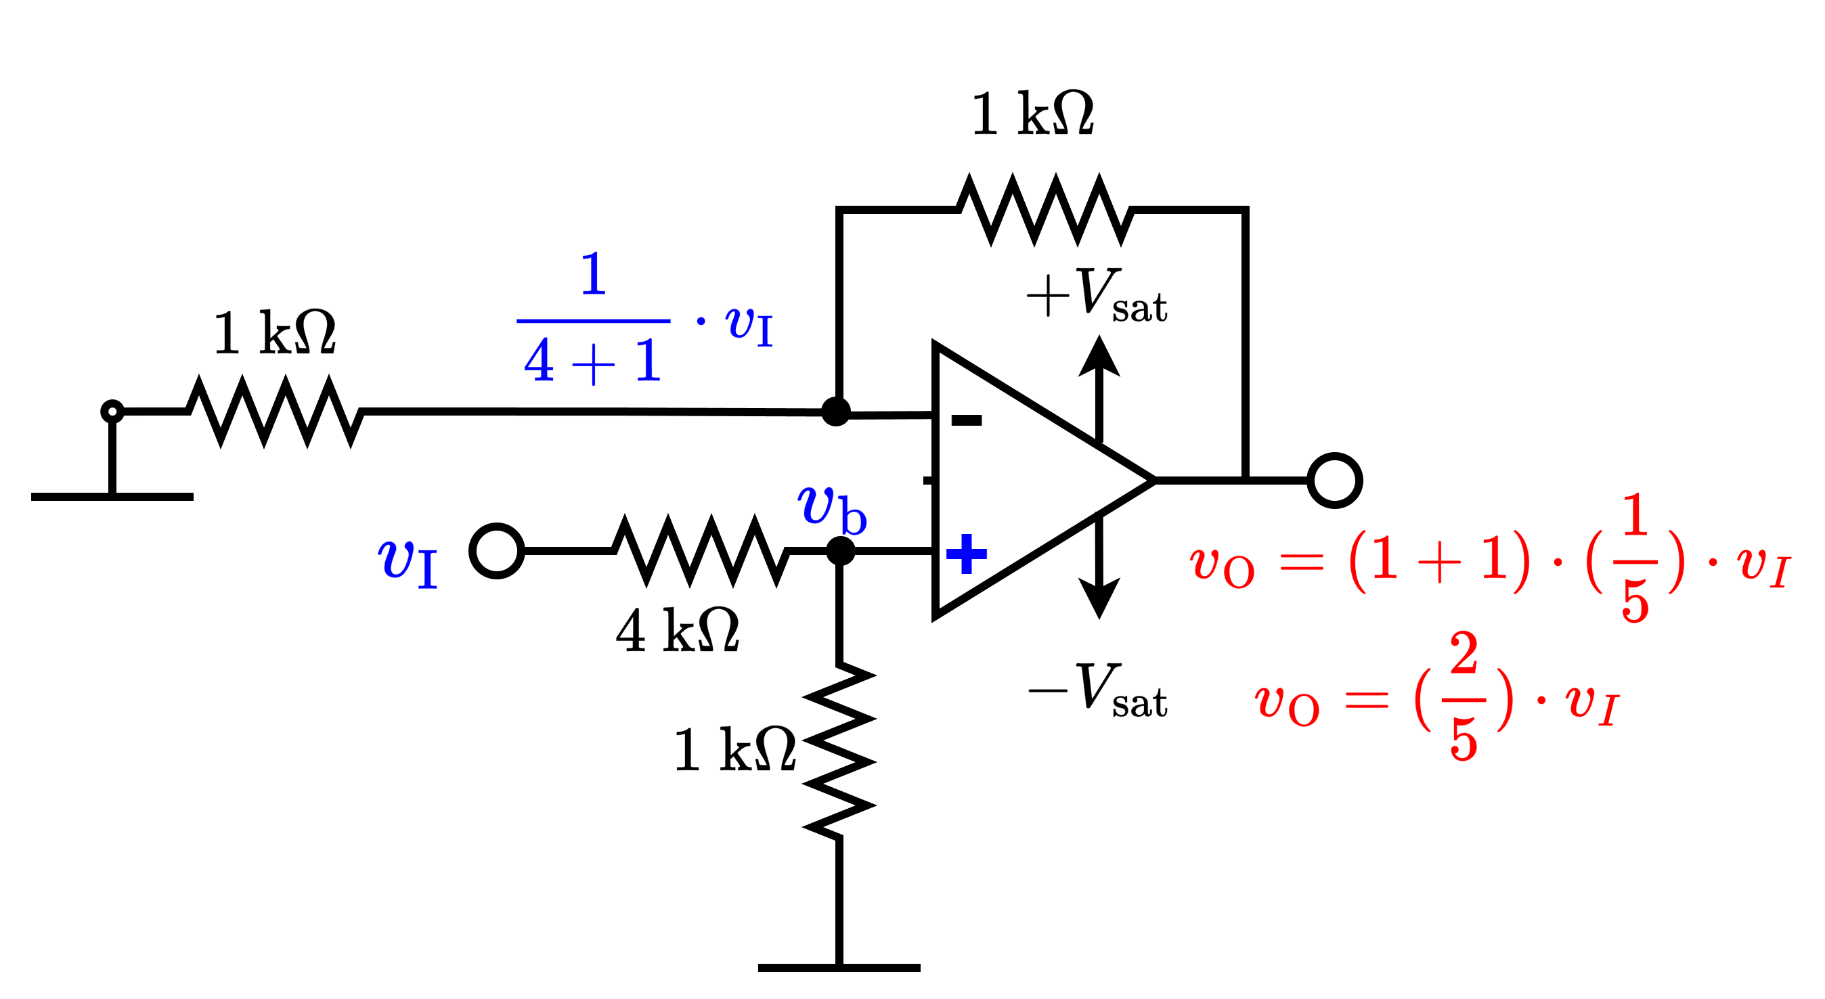
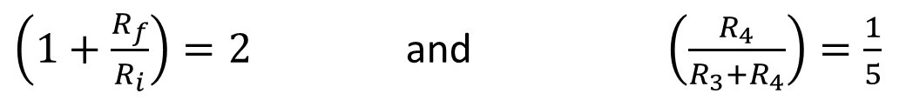
Non-Inverting Amplifier – VTC
Draw an Op-Amp Circuit with the following VTC. (What if the slope is less than 1?)
Slope $=\frac{8−2}{20−5}=\frac{2}{5}<1$
$\left(1+\frac{R_{f}}{R_{i}}\right)=2$ and $\left(\frac{R_{4}}{R_{3}+R_{4}}\right)=\frac{1}{5}$

